Slide 1




SQL and Power BI Reports
Atilq Hardware
Ad-hoc Insights
Consumer goods
By Karan Chaskar
Power BI

Slide 2


Atilq Hardware
Content
About Atliq Hardware
Task to Perform
Database
Data Model
Ad-hoc Insights
Domain: Consumer Goods
Outputs / Visualization
Key Insights
Dashboard

Slide 3

Introduction
Atliq Hardwares is one of the leading computer hardware producers in India and well expanded in other countries too.
Atliq Hardware operates in 27 countries worldwide across four main regions: Asia Pacific (APAC), Europe (EU), North America (NA), and Latin America (LATAM).
The company serves a total of 74 customers across these regions.
Atliq Hardware offers products in three main divisions: Peripherals and Accessories (P & A), Network and Storage (N & S), and Personal Computer (PC).

Slide 4


 | Step 1 | There are 10 ad hoc requests for which the business needs insights.
 | Step 2 | We need to run a SQL query to answer these requests.
 | Step 3 | The target audience of this dashboard is top-level management - hence we need to create a presentation to show the insights.
Task to Perform

Slide 5


Ad-hoc requests along with the queried results, visualization and insights
Queried Result Tools
Visualization Tool
MySQL
Power BI
MySQL is a relational database that uses structured query language
Power BI is a Microsoft tool that helps businesses analyze and visualize data

Slide 6


Database
The dataset of fiscal year 2020 and 2021 is available.
Atliq Hardwares fiscal year starts from 1st September and ends on 31st August
MySQL Database : atliq_hardware_db
Product Details : dim_product
Customer Information : dim_customer
Gross prices of product throughout the fiscal year : fact_gross_price
Manufacturing cost of product : fact_manufacturing_cost
Pre invoice deduction made during fiscal year 2020-2021 : fact_pre_invoice_deduction
Monthly sales insights of products of Atliq Hardware : fact_sales_monthly

Slide 7
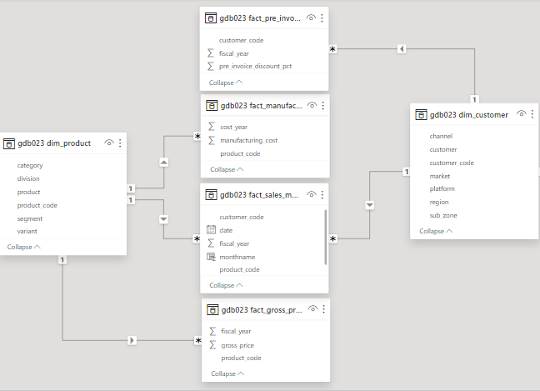

Data Model
Table Relationship

Slide 8

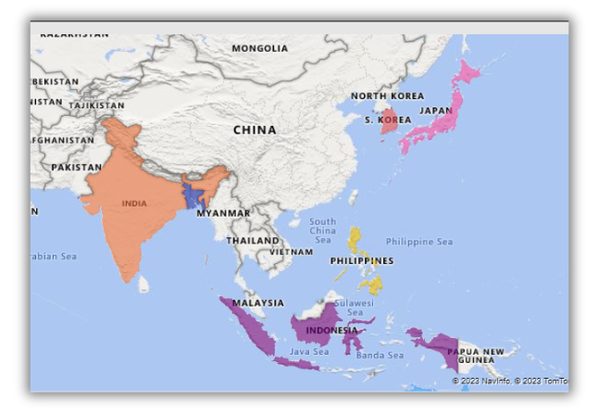
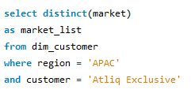
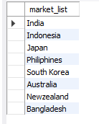
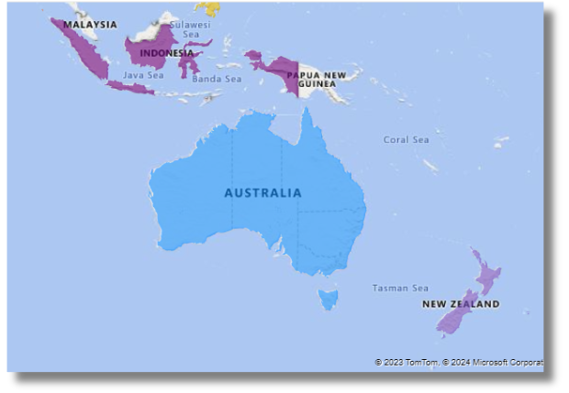
Provide the list of markets in which customer "Atliq Exclusive" operates its business in the APAC region.
MySQL Query
In the APAC region, Altiq Exclusive store established its presence in 8 major markets

Slide 9

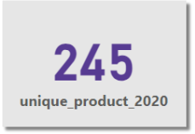
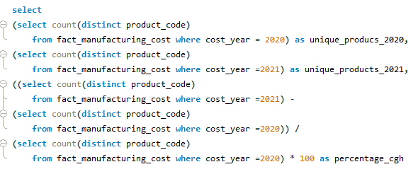
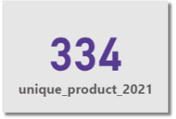
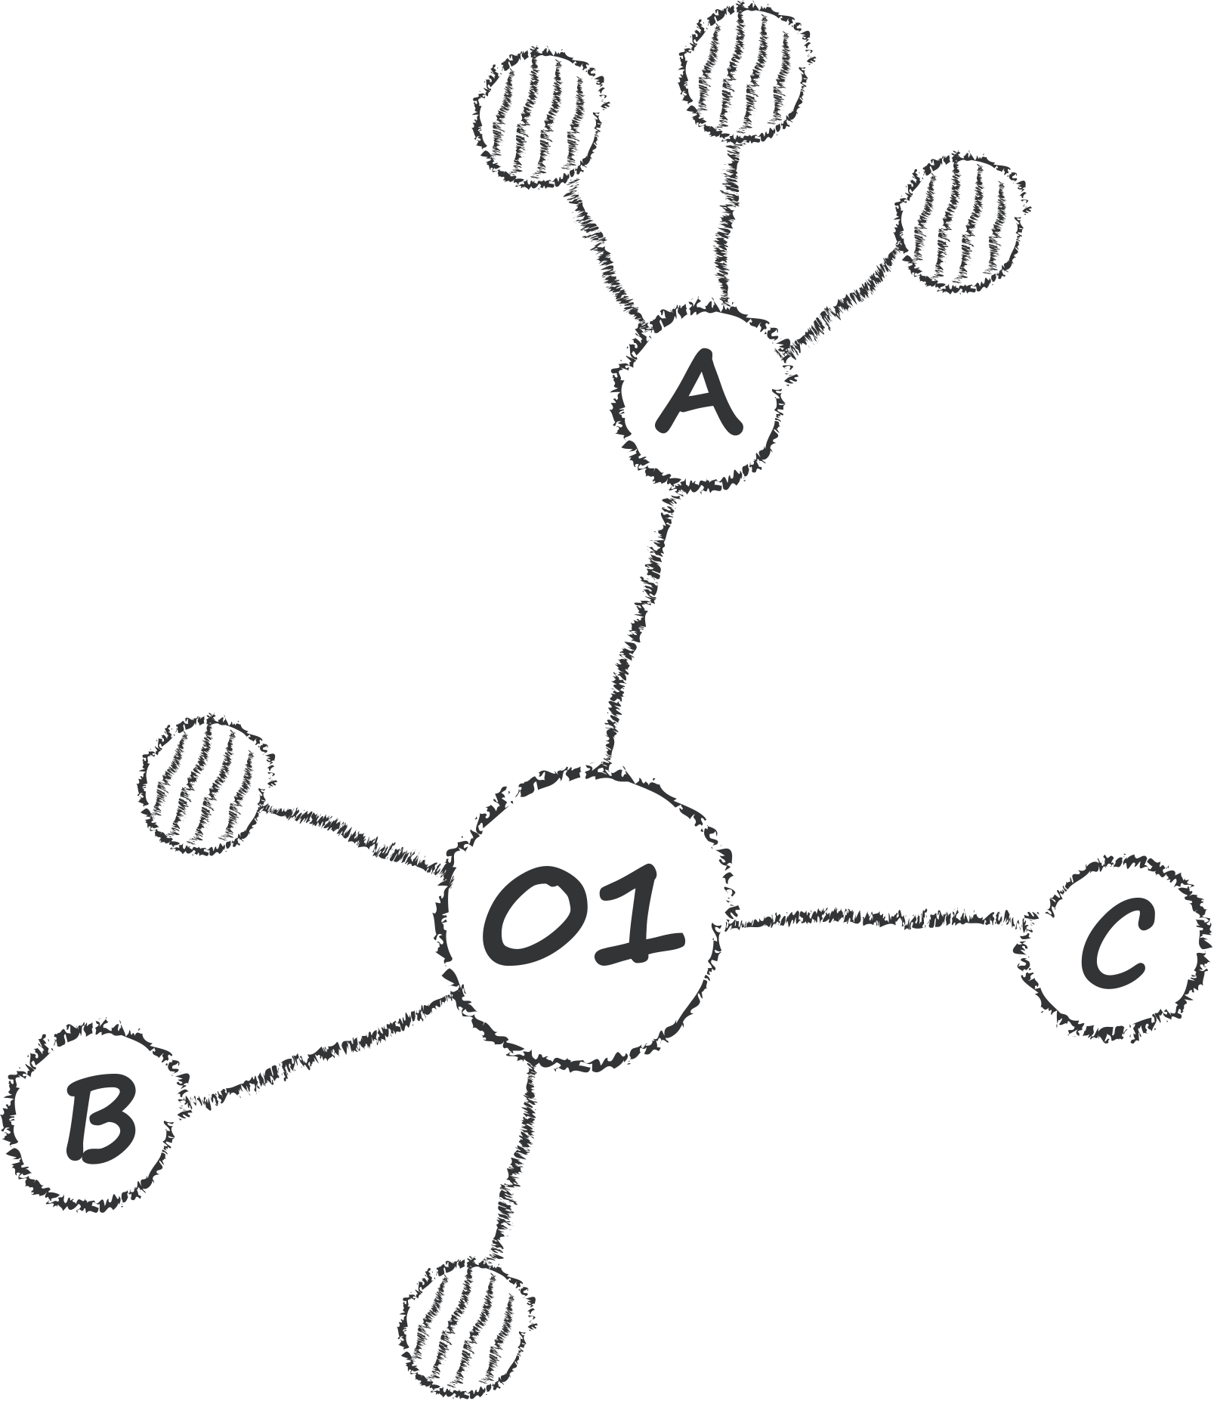
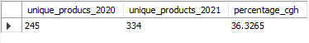
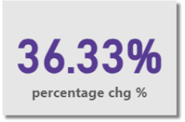
What is the percentage of unique product increase in 2021 vs. 2020?
MySQL Query
A 36.33% increase in unique product count from 2020 to 2021 may indicate that the business has grown significantly in the past year

Slide 10

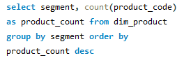
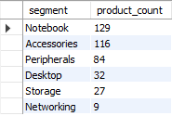
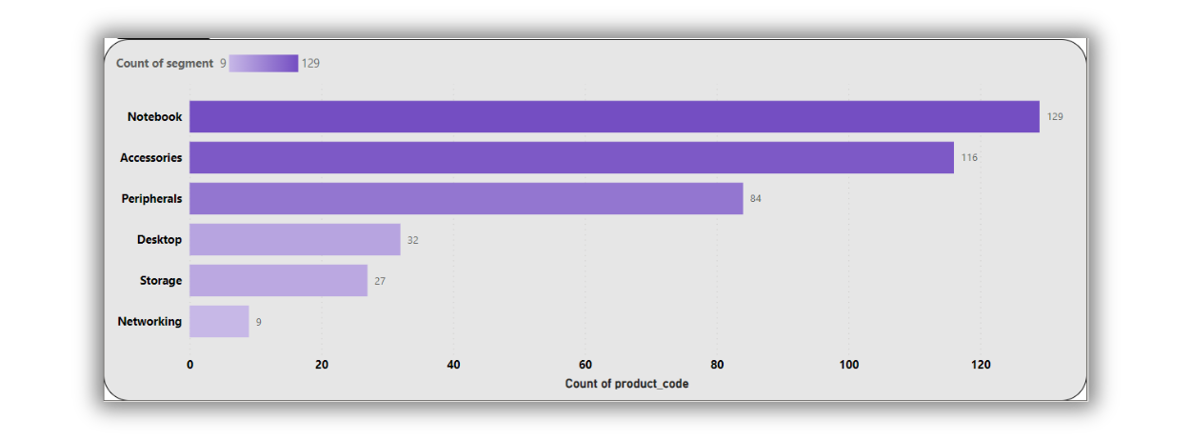
Provide a report with all the unique product counts for each segment and sort them in descending order of product counts.
MySQL Query
Atliq provides a wide range of products that includes Notebooks, Accessories, Peripherals at good level.
Where Desktop, Storage and Networking in low market demand of Atliq.

Slide 11

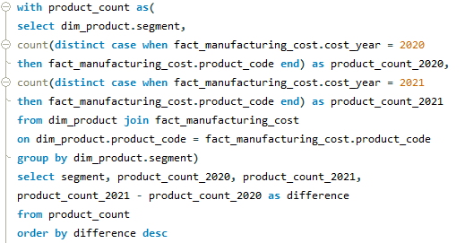
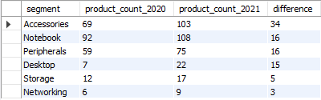
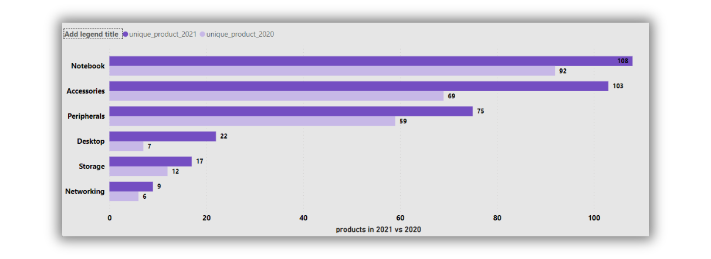
Follow-up: Which segment had the most increase in unique products in 2021 vs. 2020?
MySQL Query
Accessories segment had the largest increase in unique products from 2020 to 2021.
Where the Networking segment had the lowest increase in unique products from 2020 to 2021.

Slide 12
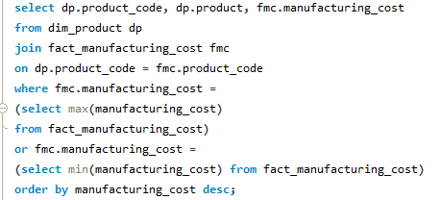
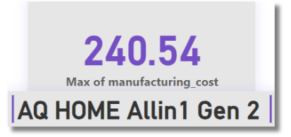
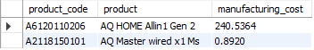
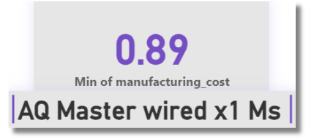

Get the products that have the highest and lowest manufacturing costs
MySQL Query
AQ Home Allin1 Gen 2 has the highest manufacturing cost
AQ Master wired x1 Ms has the lowest manufacturing cost

Slide 13

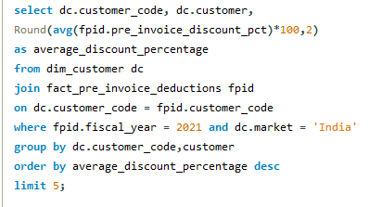

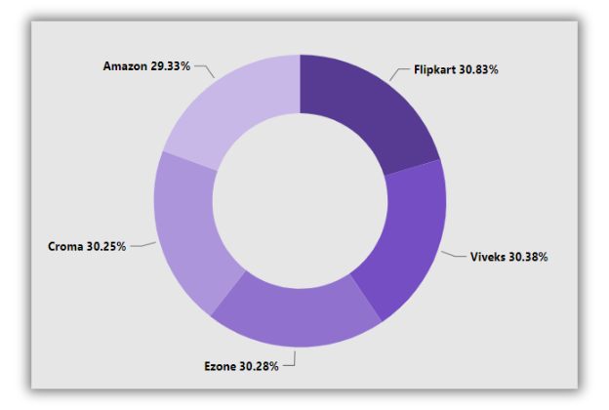
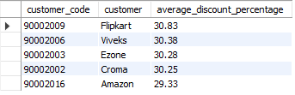
Generate a report which contains the top 5 customers who received an average high pre_invoice_discount_pct for the fiscal year 2021 and in the Indian market.
MySQL Query
The total average pre-invoice discount percentage of these 5 customers is 30.21%.

Slide 14
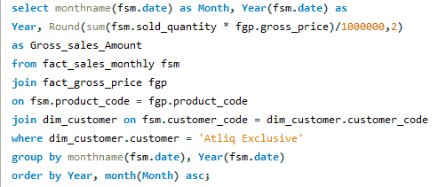
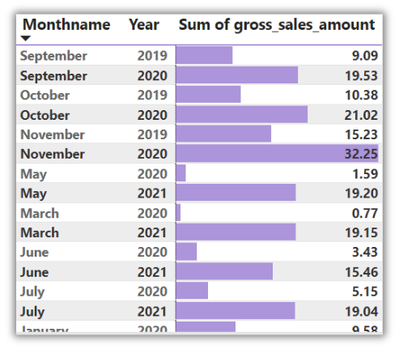
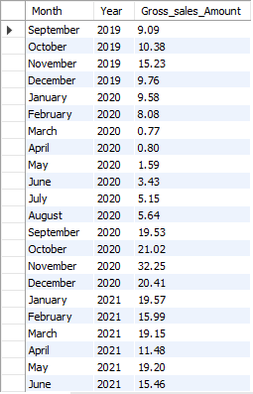
Get the complete report of the Gross sales amount for the customer “Atliq Exclusive” for each month . This analysis helps to get an idea of low and high-performing months and take strategic decisions.
MySQL Query
November 2020, shows the highest gross sales of $20.46M March 2020 shows the lowest gross sales of $0.38M Fiscal year 2020 – $39.33 and fiscal year 2021 – $142.19

Slide 15

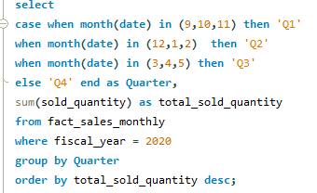
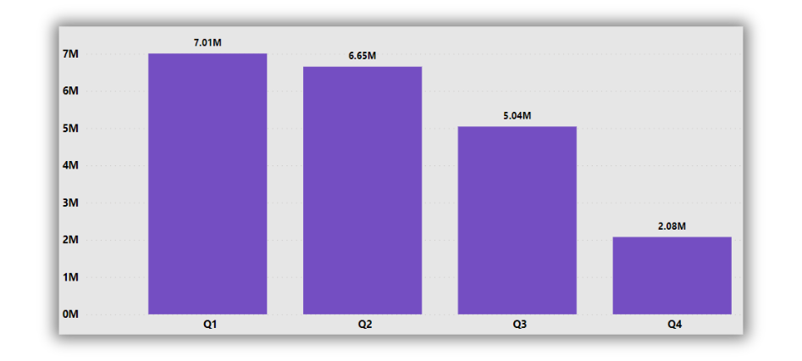

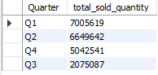
In which quarter of 2020, got the maximum total_sold_quantity?
MySQL Query
Q1 had the highest sales figure, followed by Q2, Q4, and Q3 with the lowest sales figure

Slide 16
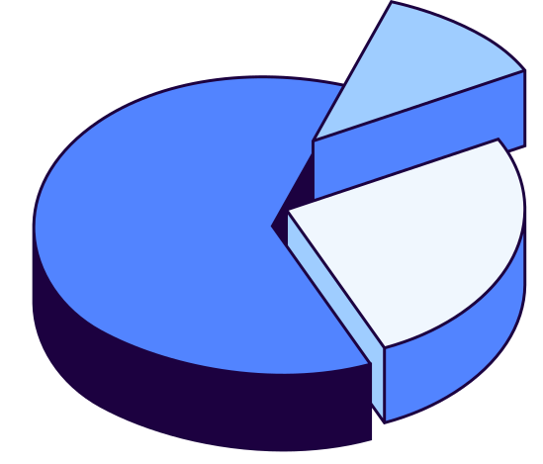
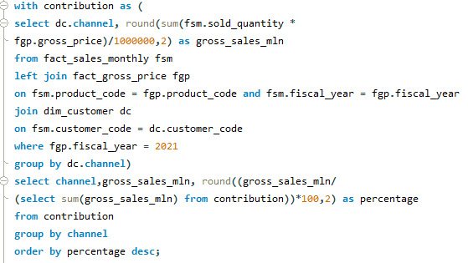
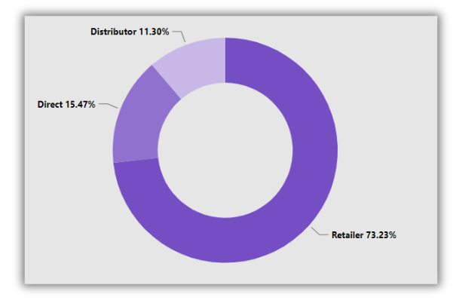
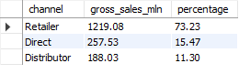
Which channel helped to bring more gross sales in the fiscal year 2021 and the percentage of contribution?
MySQL Query
Retailers contributed the highest percentage of gross sales (73.23%), followed by direct sales (15.47%) and distributors (11.30%).

Slide 17

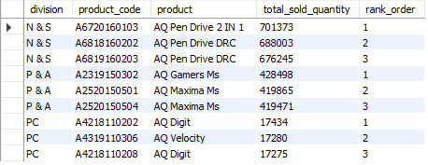
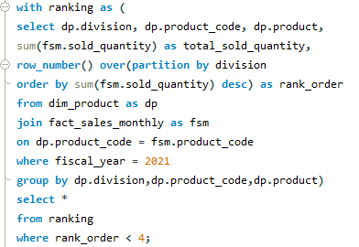
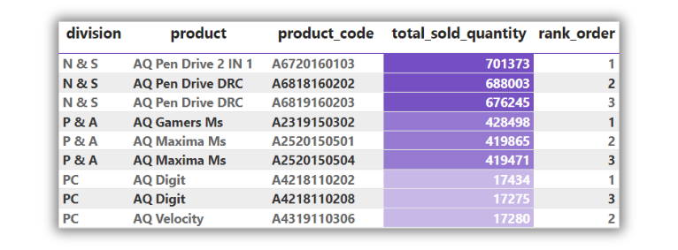
Get the Top 3 products in each division that have a high total_sold_quantity in the fiscal_year 2021?
MySQL Query
Network and Storage (N & S) – AQ Pen Drive 2 IN 1 Peripherals and Accessories (P & A) – AQ Gamer Ms Personal Computer (PC) – AQ Digit

Slide 18
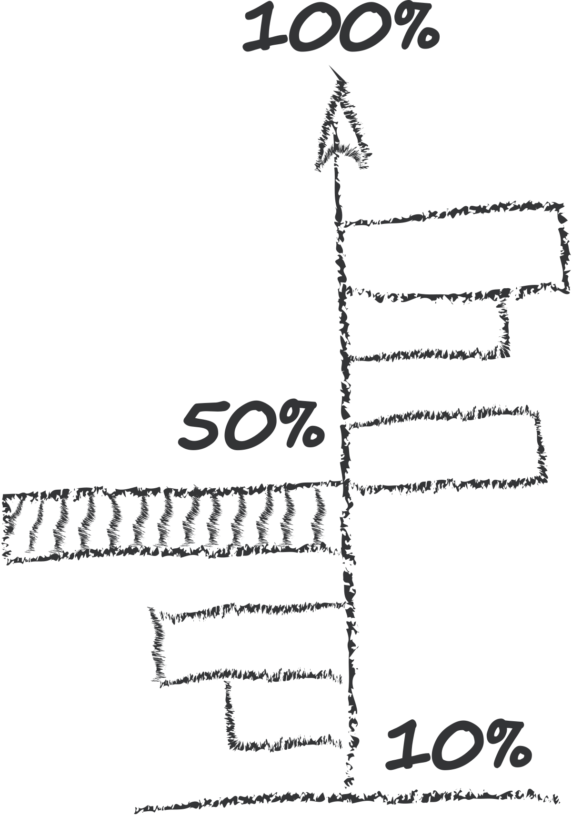
Key Insights
"Atliq Exclusive" operates its business in the following APAC countries: Australia, Bangladesh, India, Indonesia, Japan, New Zealand, Philippines, and South Korea. | The total average pre-invoice discount percentage of these 5 customers is 30.21%.
A 36.33% increase in unique product count from 2020 to 2021 may indicate that the business has grown significantly in the past year | November 2020, shows the highest gross sales of $20.46M March 2020 shows the lowest gross sales of $0.38M Fiscal year 2020 – $39.33 and fiscal year 2021 – $142.19
Atliq provides a wide range of products that includes Notebooks, Accessories, Peripherals at good level. | Quarter 1 shows the highest count of sales in the year 2021
34 new product items in Accessories has been introduced in the year 2021 whereas desktop shows the highest percentage increase (214%) from 2020 to 2021. | Retailer contributed the highest percentage of gross sales : 73.23%, followed by Direct sales and Distributers.
AQ Home Allin1 Gen 2 has the highest manufacturing cost AQ Master wired x1 Ms has the lowest manufacturing cost | In Network and Storage AQ Pen Drive 2 in 1 has highest sold quantity. same in Peripheral and Accessories is AQ Gamer MS Personal and in Computer is AQ Digit with highest sold quantity.

Slide 19


Thank You
Data Source
Domain: Consumer Goods
Function: Executive Management
Database: MySQL
Visualization Tool: Power Bi
Website: codebasics.io/challenge/codebasics-resume-project-challenge/7

